Slide 1






Financial Analysis
Coca-Cola (KO) Historical Stock Performance Analysis
A comprehensive exploration of Coca-Cola's stock trends, trading activity, and price volatility from 1960 to 2025
November 2025
Author: Rabin Shahi
Report Generated: November 2025

Slide 2









Project Introduction
This project focuses on analyzing the historical performance of Coca-Cola Company (KO) using data analysis tools—Python, SQL, and Tableau.
Python
SQL
Tableau
For data manipulation and statistical analysis
For querying and extracting key insights from the dataset
For data visualization and interactive exploration
Project Objectives
Explore long-term trends in Coca-Cola's stock performance
Analyze trading activity and volume patterns
Examine price volatility over time
Identify patterns and anomalies in stock behavior
2 / 8

Slide 3

















Dataset Overview
Data Source
16,023
The historical stock data for The Coca-Cola Company (KO) was sourced from Yahoo Finance via Kaggle.
Records
Dataset stored in MySQL database named rabin under the table coca_cola_data.
Key Attributes
Date
Open
High
Trading date
Stock price at market opening
Highest price during the day
Low
Close
Volume
Lowest price during the day
Stock price at market close
Number of shares traded
Ticker:
KO
Company:
The Coca-Cola Company
3 / 8

Slide 4

















Data Quality and Cleaning
Ensuring data accuracy was critical for reliable analysis of Coca-Cola stock performance.
Initial Records
Inconsistent Records
Final Records
Data Quality
16,066
43
16,023
99.7%
Data Quality Checks Performed
Missing Values
Duplicate Records
No missing values detected across attributes.
No duplicate records found.
Inconsistent Data
Data Validation
43 rows with 'Low' price > 'Open' price were removed.
Final dataset verified for accuracy and consistency.
4 / 8

Slide 5









SQL Analysis Highlights
Key findings from SQL queries on Coca-Cola's stock data (1960-2025)
$65.20
$0.045
63%
Highest Closing
Price
Lowest Opening Price
Bullish Days
Trading Volume Spike
Yearly Trends
Highest trading volume of 98,300,000 shares on 2020-03-16
Steady growth in average closing prices over time
Monthly Patterns
Market Sentiment
Slight dips in March & September observed
Approximately 63% of trading days closed higher than opening
5 / 8

Slide 6













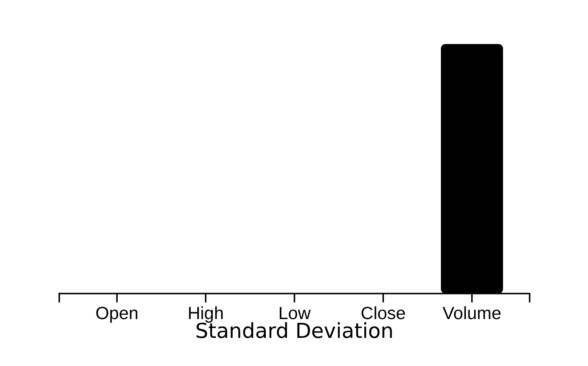







Statistical Summary
Python-based statistical summary quantifying Coca-Cola's stock characteristics, including measures of central tendency and dispersion.
Metric
Open
High
Low
Close
Volume
Standard Deviation by Metric
Mean
32.94
33.44
32.42
32.93
6,570,000
Min
0.045
0.045
0.045
0.045
50,000
Max
65.00
65.12
64.80
65.20
98,300,000
Std. Dev.
18.25
18.27
18.23
18.25
3,760,000
Standard deviation measures price volatility
Lower values indicate more stability
Key Observations:
Mean closing price of 32.93 USD indicates the average stock value over the analyzed period
Standard deviation of approximately 18.25 suggests moderate price volatility
6 / 8

Slide 7










Key Insights
Long-term Growth
Trading Volume Spike
Coca-Cola's stock has demonstrated consistent appreciation from the 1960s to 2025, indicating a strong long-term growth trajectory.
A significant spike in trading volume was observed in 2020, aligning with the increased market volatility experienced during the pandemic.
Bullish Consistency
Seasonal Patterns
Approximately 63% of trading days saw the stock close higher than its opening price, highlighting a consistent bullish trend.
Analysis revealed that the months of January through April generally show higher average closing prices.
Overall Stability: The stock exhibits a relatively narrow price range on most trading days, suggesting that Coca-Cola's stock is generally stable.
7 / 8

Slide 8




Conclusion and Summary
In summary, the comprehensive analysis of Coca-Cola's historical stock performance reveals it to be a relatively stable investment with consistent long-term growth. Despite periods of market volatility, such as the volume spike in 2020, the stock has maintained a steady upward trend and exhibits predictable seasonal patterns.
Long-term Growth
Stability
Trading Activity
Coca-Cola's stock has demonstrated consistent appreciation from the 1960s to 2025, indicating a strong long-term growth trajectory.
The stock exhibits a relatively narrow price range on most trading days, suggesting that Coca-Cola's stock is generally stable.
A significant spike in trading volume was observed in 2020, aligning with the increased market volatility experienced during the pandemic.
Bullish Consistency
Seasonal Behavior
63%
Approximately 63% of trading days saw the stock close higher than its opening price, highlighting a consistent bullish trend.
Analysis revealed that the months of January through April generally show higher average closing prices.
8 / 8

